Slide 1


Principles of Information Security,
Fourth Edition
Chapter 10
Implementing Information Security

Slide 2
Learning Objectives
Upon completion of this material, you should be able to:
  Explain how an organization’s information security blueprint becomes a project plan
  Enumerate the many organizational considerations that a project plan must address
  Explain the significance of the project manager’s role in the success of an information security project
  Establish the need for professional project management for complex projects
Principles of Information Security, Fourth Edition
Notes:
Upon completion of this material you should be able to:
Understand how the organization’s security blueprint becomes a project plan
Identify the main components of a project using the work breakdown structure (WBS) method
Grasp the significant role and importance of the project manager in the success of an information security project
Understand the need for professional project management for complex projects
Identify the key elements of the bull’s-eye method as presented in this chapter
Grasp the problems that organizations face in times of rapid change

Slide 3
Learning Objectives (cont’d.)
  Describe technical strategies and models for implementing a project plan
  Anticipate and mitigate the nontechnical problems that organizations face in times of rapid change
Principles of Information Security, Fourth Edition

Slide 4
Introduction
SecSDLC implementation phase is accomplished through changing configuration and operation of organization’s information systems
Implementation includes changes to:
  Procedures (through policy)
  People (through training)
  Hardware (through firewalls)
  Software (through encryption)
  Data (through classification)
Organization translates blueprint for information security into a concrete project plan
Principles of Information Security, Fourth Edition
Notes:
Introduction
In general, the implementation phase is accomplished by changing the configuration and operation of the organization’s information systems to make them more secure.
It includes changes to:
Procedures (through policy)
People (through training)
Hardware (through firewalls)
Software (through encryption)
Data (perhaps through classification)
During the implementation phase, the organization translates its blueprint for information security into a concrete project plan.
The project plan delivers instructions to the individuals who are executing the implementation.
These instructions focus on the security control changes that are needed to improve the hardware, software, procedures, data, and people that make up the organization’s information systems.
But before a project plan can be developed, management should have articulated and coordinated the information security vision and objectives involved in the execution of the plan.

Slide 5
Information Security Project Management
Once organization’s vision and objectives are understood, process for creating project plan can be defined
Major steps in executing project plan are:
  Planning the project
  Supervising tasks and action steps
  Wrapping up
Each organization must determine its own project management methodology for IT and information security projects
Principles of Information Security, Fourth Edition
Notes:
Project Management in the Implementation Phase
Once the organization’s vision and objectives are documented and understood, the processes for translating the blueprint into a project plan can be defined.
Organizational change is not easily accomplished.
The major steps in executing the project plan are:
Planning the project
Supervising tasks and action steps within the project plan
Wrapping up the project plan
The project plan can be developed in any number of ways.
Each organization has to determine its own project management methodology for IT and information security projects.
Whenever possible, information security projects should follow the organizational practices of project management.
If your organization does not have clearly defined project management practices, the following general guidelines on project management practices can be applied.

Slide 6
Developing the Project Plan
Creation of project plan can be done using work breakdown structure (WBS)
Major project tasks in WBS are:
  Work to be accomplished
  Assignees
  Start and end dates
  Amount of effort required
  Estimated capital and noncapital expenses
  Identification of dependencies between/among tasks
Each major WBS task is further divided into smaller tasks or specific action steps
Principles of Information Security, Fourth Edition
Notes:
Developing the Project Plan
Planning for the implementation phase involves the creation of a detailed project plan.
The creation of the project plan can be accomplished using a simple planning tool, such as the work breakdown structure (WBS).
Common task attributes are:
Work to be accomplished (activities and deliverables)
Individuals (or skills set) assigned to perform the task
Start and end dates for the task (when known)
Amount of effort required for completion in hours or work days
Estimated capital expenses for the task
Estimated noncapital expenses for the task
Other tasks on which the task depends
Each major task is then further divided into either smaller tasks or specific action steps.
Key components of the project plan are:
Identify work to be accomplished.
Describe the skill set or individual person needed to accomplish the task.
Focus on determining only completion dates for major milestones.
Estimate the expected capital expenses for the completion of this task, subtask, or action item.
Estimate the expected noncapital expenses for the completion of the task, subtask, or action item.
Note wherever possible the dependencies of other tasks or action steps on the task or action step at hand.

Slide 7
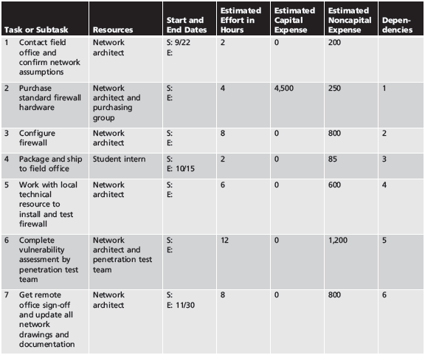
Table 10-1 Example Project Plan Work Breakdown Structure–Early Draft
Principles of Information Security, Fourth Edition

Slide 8
Project Planning Considerations
As project plan is developed, adding detail is not always straightforward
Special considerations include financial, priority, time and schedule, staff, procurement, organizational feasibility, and training
Principles of Information Security, Fourth Edition
Notes:
Project Planning Considerations
As the project plan is developed, adding detail to the plan is not always straightforward.
Special considerations include:
Financial
Priority
Time
Staff
Scope
Procurement
Organizational feasibility
Training and indoctrination
Change control and technology governance

Slide 9
Project Planning Considerations (cont’d.)
Financial considerations
  No matter what information security needs exist, the amount of effort that can be expended depends on funds available
  Cost benefit analysis must be verified prior to development of project plan
  Both public and private organizations have budgetary constraints, though of a different nature
  To justify an amount budgeted for a security project at either public or for-profit organizations, it may be useful to benchmark expenses of similar organizations
Principles of Information Security, Fourth Edition
Notes:
Financial Considerations
No matter what information security needs exist in the organization, the amount of effort that can be expended depends on the funds available.
A cost benefit analysis prepared earlier in the life cycle must be verified prior to development of the project plan.
In many organizations, the information security budget is a subsection of the overall IT budget. In others, information security is a separate budget category that may have parity with the IT budget.
Both public and private organizations have budgetary constraints, albeit of a different nature.
To justify an amount budgeted for a security project at either public or for-profit organizations, it may be useful to benchmark expenses of similar organizations.

Slide 10
Project Planning Considerations (cont’d.)
Priority considerations
  In general, the most important information security controls should be scheduled first
  Implementation of controls is guided by prioritization of threats and value of threatened information assets
Principles of Information Security, Fourth Edition
Notes:
Priority Considerations
In general, the most important information security controls should be scheduled first.
The implementation of controls is guided by the prioritization of threats and the value of the information assets threatened.
A control that costs a little more and is a little lower on the prioritization list but addresses many more specific vulnerabilities and threats has higher priority than a less expensive, higher-priority component that only addresses one particular vulnerability.

Slide 11
Project Planning Considerations (cont’d.)
Time and scheduling considerations
  Time impacts dozens of points in the development of a project plan, including:
    Time to order, receive, install, and configure security control
    Time to train the users
    Time to realize return on investment of control
Principles of Information Security, Fourth Edition
Notes:
Time and Scheduling Considerations
Time is another constraint that has a broad impact on the development of the project plan.
Time can affect dozens of points in the development of a project plan including the following:
Time to order and receive a security control due to backlogs of the vendor or manufacturer
Time to install and configure the control
Time to train the users
Time to realize the return on investment of the control

Slide 12
Project Planning Considerations (cont’d.)
Staffing considerations
  Lack of enough qualified, trained, and available personnel constrains project plan
  Experienced staff is often needed to implement available technologies and develop and implement policies and training programs
Principles of Information Security, Fourth Edition
Notes:
Staffing Considerations
The lack of enough qualified, trained, and available personnel also constrains the project plan.
Experienced staff is often needed to implement available technologies and to develop and implement policies and training programs.
If no staff members are trained to configure a firewall that is being purchased, someone must be trained or someone must be hired who is experienced with that particular technology.

Slide 13
Project Planning Considerations (cont’d.)
Procurement considerations
  IT and information security planners must consider acquisition of goods and services
  Many constraints on selection process for equipment and services in most organizations, specifically in selection of service vendors or products from manufacturers/suppliers
  These constraints may eliminate a technology from realm of possibilities
Principles of Information Security, Fourth Edition
Notes:
Procurement Considerations
All IT and information security planners must consider the acquisition of goods and services.
There are a number of constraints on the selection process for equipment and services in most organizations, specifically in the selection of certain service vendors or products from manufacturers and suppliers.
These constraints may change the specifics of a particular technology or even eliminate it from the realm of possibilities.

Slide 14
Project Planning Considerations (cont’d.)
Organizational feasibility considerations
  Policies require time to develop; new technologies require time to be installed, configured, and tested
  Employees need training on new policies and technology, and how new information security program affects their working lives
  Changes should be transparent to system users unless the new technology is intended to change procedures (e.g., requiring additional authentication or verification)
Principles of Information Security, Fourth Edition
Notes:
Organizational Feasibility Considerations
Policies require time to develop and new technologies require time to be installed, configured, and tested.
Employees need to understand how a new infosec program impacts their working lives.
The goal of the project plan is to avoid new security components from directly impacting the day-to-day operations of the individual employees.
This means that changes should be transparent to systems users, unless the new technology causes changes to procedures, such as requiring additional authentication or verification.

Slide 15
Project Planning Considerations (cont’d.)
Training and indoctrination considerations
  Size of organization and normal conduct of business may preclude a single large training program on new security procedures/technologies
  Thus, organization should conduct phased-in or pilot approach to implementation
Principles of Information Security, Fourth Edition
Notes:
Training and Indoctrination Considerations
The size of the organization and the normal conduct of business may preclude a single large training program on security procedures or technologies.
As a result, the organization should conduct a phased in or pilot approach to implementation, such as “roll-out” training for one department at a time.
In the case of policies, it may be sufficient to brief all supervisors on new policy and then have the supervisors update end users in normal meetings.
Ensure that compliance documents are also distributed, requiring all employees to read, understand, and agree to the new policies.

Slide 16
Scope Considerations
Project scope: concerns boundaries of time and effort-hours needed to deliver planned features and quality level of project deliverables
In the case of information security, project plans should not attempt to implement the entire security system at one time
Principles of Information Security, Fourth Edition
Notes:
Scope Considerations
Project scope concerns the boundaries of time and effort-hours needed to deliver the planned features and quality level of the
project deliverables.
In the case of information security, project plans should not attempt to implement the entire security system at one time.
In addition to the constraints of handling so many complex tasks at one time, information security implementations experience the problems of having interrelated conflicts between the installation of information security
controls and the daily operations of the organization.
In addition, the installation of new information security controls may conflict with existing controls.

Slide 17
The Need for Project Management
Project management requires a unique set of skills and thorough understanding of a broad body of specialized knowledge
Most information security projects require a trained project manager (a CISO) or skilled IT manager versed in project management techniques
Principles of Information Security, Fourth Edition
Notes:
The Need for Project Management
Project management requires a unique set of skills and a thorough understanding of a broad body of specialized knowledge.
It is a realistic assumption that most information security projects require a trained project manager, CISO, or skilled IT manager versed in project management techniques to oversee the project.
In addition, when selecting advanced or integrated technologies or outsourced services, even experienced project managers are advised to seek expert assistance when engaging in a formal bidding process.

Slide 18
The Need for Project Management (cont’d.)
Supervised implementation
  Some organizations may designate champion from general management community of interest to supervise implementation of information security project plan
  An alternative is to designate senior IT manager or CIO to lead implementation
  Optimal solution is to designate a suitable person from information security community of interest
  It is up to each organization to find the most suitable leadership for a successful project implementation
Principles of Information Security, Fourth Edition
Notes:
Supervising Implementation
Some organizations may designate a champion from general management to supervise the implementation of the project plan for security information.
An alternative is to designate a senior IT manager or the CIO of the organization to lead the implementation.
The optimal solution is to designate a suitable person from the information security community of interest, since the inherent focus is on the information security needs of the organization.
In the final analysis, it is up to each organization to find the leadership for a successful project implementation that best suits its specific needs and the personalities and politics of the organizational culture.

Slide 19
The Need for Project Management (cont’d.)
Executing the plan
  Negative feedback ensures project progress is measured periodically
    Measured results compared against expected results
    When significant deviation occurs, corrective action taken
  Often, project manager can adjust one of three parameters for task being corrected:
    Effort and money allocated
    Scheduling impact
    Quality or quantity of deliverable
Principles of Information Security, Fourth Edition
Notes:
Executing the Plan
Once a project is underway, it is managed to completion using a process known as a negative feedback loop or cybernetic loop, which ensures that progress is measured periodically.
The measured results are compared against expected results.
When significant deviation occurs, corrective action is taken to bring the task that is deviating from plan back into compliance with the projection, or else the estimate is revised in light of new information.
When corrective action is required, there are two basic situations: either the estimate was flawed or performance has lagged.
When an estimate is flawed, for example a faulty estimate for effort-hours is discovered, the plan should be corrected and downstream tasks updated to reflect the change.
When performance has lagged, for example due to high turnover of skilled employees, correction is required by adding resources, lengthening the schedule, or by reducing the quality or quantity of the deliverable.
The decisions are usually expressed in terms of trade-offs.
Often a project manager can adjust one of the three planning parameters for the task being corrected:
1. Effort and money allocated
2. Elapsed time or scheduling impact
3. Quality or quantity of the deliverable

Slide 20
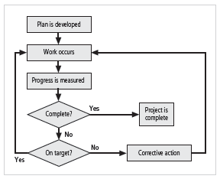
Figure 10-1 Negative Feedback Loop
Principles of Information Security, Fourth Edition

Slide 21
The Need for Project Management (cont’d.)
Project wrap-up
  Project wrap-up is usually handled as procedural task and assigned to mid-level IT or information security manager
  Collect documentation, finalize status reports, and deliver final report and presentation at wrap-up meeting
  Goal of wrap-up is to resolve any pending issues, critique overall project effort, and draw conclusions about how to improve process
Principles of Information Security, Fourth Edition
Notes:
Wrap-up
Project wrap-up is usually handled as a procedural task assigned to a mid-level IT or information security manager.
These managers collect documentation, finalize status reports, and deliver a final report and a presentation at a wrap-up meeting.
The goal of the wrap-up is to resolve any pending issues, critique the overall effort of the project, and draw conclusions about how to improve the process for the future.

Slide 22
Technical Aspects of Implementation
Some parts of implementation process are technical in nature, dealing with application of technology
Others are not, dealing instead with human interface to technical systems
Principles of Information Security, Fourth Edition
Notes:
Technical Topics of Implementation
Some parts of the implementation process are technical in nature, dealing with the application of technology, while others are not, dealing instead with the human interface to technical systems.

Slide 23
Conversion Strategies
As components of new security system are planned, provisions must be made for changeover from previous method of performing task to new method
Four basic approaches:
  Direct changeover
  Phased implementation
  Pilot implementation
  Parallel operations
Principles of Information Security, Fourth Edition
Notes:
Conversion Strategies
As the components of the new security system are planned, provisions must be made for the changeover from the previous method of performing a task to the new methods.
1. Direct changeover: Also known as going “cold turkey,” involves stopping the old method and beginning the new.
2. Phase implementation: The most common approach, involves rolling out a piece of the system across the entire organization.
3. Pilot implementation: Involves implementing all security improvements in a single office, department, or division, and resolving issues within that group before expanding to the rest of the organization.
4. Parallel operations: Involve running the new methods alongside the old methods.

Slide 24
The Bull’s-Eye Model
Proven method for prioritizing program of complex change
Issues addressed from general to specific; focus is on systematic solutions and not individual problems
Relies on process of evaluating project plans in progression through four layers:
  Policies
  Networks
  Systems
  Applications
Principles of Information Security, Fourth Edition
Notes:
The Bull’s-Eye Model for InfoSec Project Planning
By reviewing the information security blueprint and the current state of the organization’s information security efforts in terms of the four layers of the bulls-eye model, project planners can find guidance about where to lobby for expanded information security capabilities.
This approach relies on a process of evaluating project plans in a progression through four layers: policy, network, systems, and applications.
The bull’s-eye model can be used to evaluate the sequence of steps taken to integrate parts of the information security blueprint into a project plan, meaning that:
Until sound and useable IT and information security policy is developed, communicated, and enforced, no additional resources should be spent on other controls.
Until effective network controls are designed and deployed, all resources should be spent to achieve that goal.
After policy and network controls are implemented, implementation should focus on the information, process, and manufacturing systems of the organization.
Once there is assurance that policy is in place, networks are secure, and systems are safe, attention should move to the assessment and remediation of the security of the organization’s applications.

Slide 25
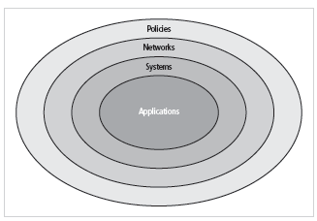
Figure 10-2 The Bull’s-Eye Model
Principles of Information Security, Fourth Edition

Slide 26
To Outsource or Not
Just as some organizations outsource IT operations, organizations can outsource part or all of information security programs
Due to complex nature of outsourcing, it’s advisable to hire best outsourcing specialists and retain best attorneys possible to negotiate and verify legal and technical intricacies
Principles of Information Security, Fourth Edition
Notes:
To Outsource or Not
Just as some organizations outsource IT operations, so too can organizations outsource part of or all of their information security programs.
When an organization has outsourced IT services, information security should be part of the contract arrangement with the outsourcer.
Because of the complex nature of outsourcing, the best advice is to hire the best outsourcing specialists, and then have the best attorney possible negotiate and verify the legal and technical intricacies of the outsourcing contract.

Slide 27
Technology Governance and Change Control
Technology governance
  Complex process an organization uses to manage impact and costs from technology implementation, innovation, and obsolescence
By managing the process of change, organization can:
  Improve communication; enhance coordination; reduce unintended consequences; improve quality of service; and ensure groups are complying with policies
Principles of Information Security, Fourth Edition
Notes:
Technology Governance and Change Control
Other factors that determine the success of an organization’s IT and information security are technology governance and change control processes.
Technology governance is a complex process that an organization uses to manage the impacts and costs caused by technology implementation, innovation, and obsolescence.
Technology governance also facilitates the communication about technical advances and issues across the organization.
Medium or large organizations deal with the impact of technical change on the operation of the organization through a change control process.
By managing the process of change, the organization can:
Improve communication about change
Enhance coordination between organizational groups as change is scheduled and completed
Reduce unintended consequences by having a process to resolve potential conflict and disruption
Improve quality of service as potential failures are eliminated and groups work together
Assure management that all groups are complying with the organization’s policies regarding technology governance, procurement, accounting, and information security

Slide 28
Nontechnical Aspects of Implementation
Other parts of implementation process are not technical in nature, dealing with the human interface to technical systems
Include creating a culture of change management as well as considerations for organizations facing change
Principles of Information Security, Fourth Edition
Notes:
Nontechnical Topics of Implementation
Other parts of the implementation process are not technical in nature, dealing with the human interface to technical systems.
These include the topics of creating a culture of change management as well as some considerations for organizations facing change.

Slide 29
The Culture of Change Management
Prospect of change can cause employees to build up resistance to change
The stress of change can increase the probability of mistakes or create vulnerabilities
Resistance to change can be lowered by building resilience for change
Lewin change model:
  Unfreezing
  Moving
  Refreezing
Principles of Information Security, Fourth Edition
Notes:
The Culture of Change Management
In any major project, the prospect of change, the familiar shifting to the unfamiliar, can cause employees to unconsciously or consciously resist.
Even when employees embrace changes, the stress of making changes and adjusting to the new procedures can increase the probability of mistakes or create vulnerabilities in the system.
By understanding and applying some of the basic tenets of change management, the resistance to change can be lowered and you can even build resilience for changes, making ongoing change more palatable to the entire organization.
One of the oldest models of making change is the Lewin change model , which consists of:
Unfreezing: “Thawing out” hard and fast habits and established procedures
Moving: The transition between the old way and the new
Refreezing: The integration of the new methods into the organizational culture by creating an atmosphere in which the changes are accepted as the preferred way of accomplishing the requisite tasks

Slide 30
Considerations for Organizational Change
Steps can be taken to make organization more amenable to change:
  Reducing resistance to change from beginning of planning process
  Develop culture that supports change
Principles of Information Security, Fourth Edition
Notes:
Considerations for Organizational Change
In order to make an organization more amenable to change, some steps can be taken.
This includes reducing resistance to change from the beginning of the planning process and steps taken to modify the organization to be more accepting of change.

Slide 31
Considerations for Organizational Change (cont’d.)
Reducing resistance to change from the start
  The more ingrained the previous methods and behaviors, the more difficult the change
  Best to improve interaction between affected members of organization and project planners in early project phases
  Three-step process for project managers: communicate, educate, and involve
  Joint application development
Principles of Information Security, Fourth Edition
Notes:
Reducing Resistance to Change from the Start
The level of resistance to change impacts the ease with which an organization works through the process described.
The more ingrained the previous methods and behaviors, the more difficult the change.
The primary mechanism used to overcome this resistance to change is to improve the interaction between the affected members of the organization and the project planners in the earlier phases of the SecSDLC.
The guideline to improve this interaction is a three-step process: communicate, educate, and involve.

Slide 32
Considerations for Organizational Change (cont’d.)
Developing a culture that supports change
  Ideal organization fosters resilience to change
  Resilience: organization has come to expect change as a necessary part of organizational culture, and embracing change is more productive than fighting it
  To develop such a culture, organization must successfully accomplish many projects that require change
Principles of Information Security, Fourth Edition
Notes:
Reducing Resistance to Change from the Start
The level of resistance to change impacts the ease with which an organization works through the process described.
The more ingrained the previous methods and behaviors, the more difficult the change.
The primary mechanism used to overcome this resistance to change is to improve the interaction between the affected members of the organization and the project planners in the earlier phases of the SecSDLC.
The guideline to improve this interaction is a three-step process: communicate, educate, and involve.

Slide 33
Information Systems Security Certification and Accreditation
It may seem that only systems handling secret government data require security certification and accreditation
In order to comply with the myriad of new federal regulation protecting personal privacy, organizations need to have some formal mechanism for verification and validation
Principles of Information Security, Fourth Edition

Slide 34
Information Systems Security Certification and Accreditation (cont’d.)
Certification versus accreditation
  Accreditation: authorizes IT system to process, store, or transmit information; assures systems of adequate quality
  Certification: evaluation of technical and nontechnical security controls of IT system establishing extent to which design and implementation meet security requirements
Principles of Information Security, Fourth Edition

Slide 35
Information Systems Security Certification and Accreditation (cont’d.)
SP 800-37, Rev. 1: Guidelines for the Security Certification and Accreditation of Federal Information Technology Systems
  Provides guidance for the certification and accreditation of federal information systems
  Information processed by the federal government is grouped into one of three categories:
    National security information (NSI)
    Non-NSI
    Intelligence community (IC)
Principles of Information Security, Fourth Edition

Slide 36
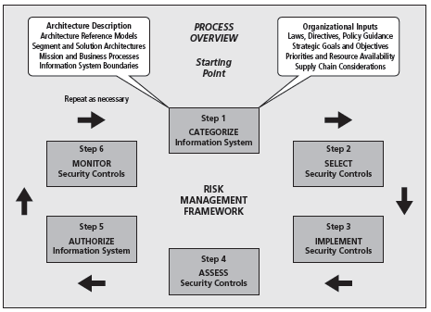
Figure 10-4 Risk Management Framework
Principles of Information Security, Fourth Edition

Slide 37
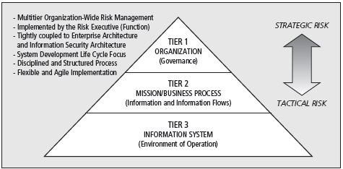
Figure 10-3 Tiered Risk Management Framework
Principles of Information Security, Fourth Edition

Slide 38
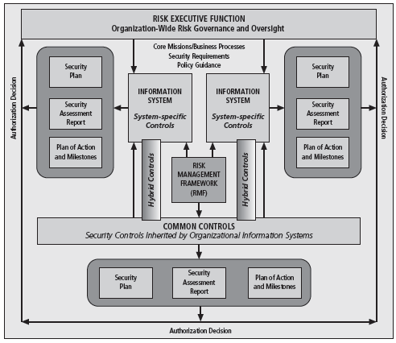
Figure 10-5 NIST SP 800-37, R.1: Security Control Allocation
Principles of Information Security, Fourth Edition

Slide 39
Information Systems Security Certification and Accreditation (cont’d.)
NSTISS Instruction-1000: National Information Assurance Certification and Accreditation Process (NIACAP)
  The NIACAP is composed of four phases
    Phase 1 – definition
    Phase 2 – verification
    Phase 3 – validation
    Phase 4 – post accreditation
Principles of Information Security, Fourth Edition

Slide 40
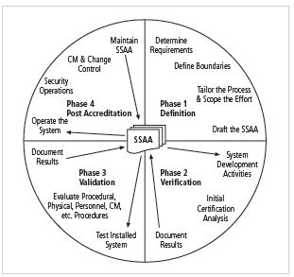
Figure 10-6 Overview of the NIACAP process
Principles of Information Security, Fourth Edition

Slide 41
Information Systems Security Certification and Accreditation (cont’d.)
ISO 27001/ 27002 Systems Certification and Accreditation
  Entities outside the United States apply the standards provided under these standards
  Standards were originally created to provide a foundation for British certification of information security management systems (ISMS)
  Organizations wishing to demonstrate their systems have met this international standard must follow the certification process
Principles of Information Security, Fourth Edition

Slide 42
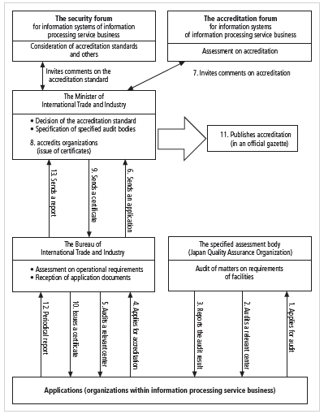
Figure 10-11 Japanese ISMS Certification and Accreditation
Principles of Information Security, Fourth Edition

Slide 43
Summary
Moving from security blueprint to project plan
Organizational considerations addressed by project plan
Project manager’s role in success of an information security project
Technical strategies and models for implementing project plan
Nontechnical problems that organizations face in times of rapid change
Principles of Information Security, Fourth Edition

